Slide 1
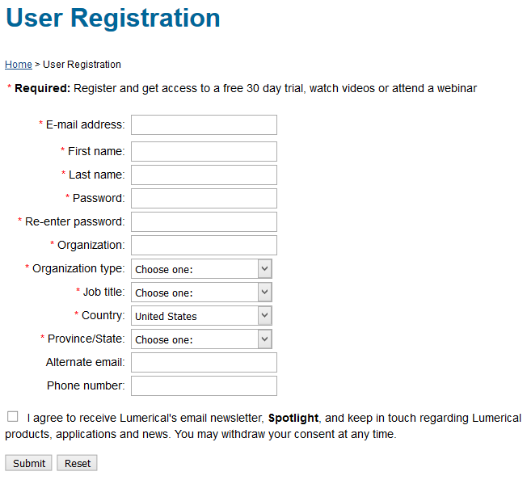
Installing FDTD Solutions
https://www.lumerical.com/register.html
Use @berkeley.edu address

Slide 2
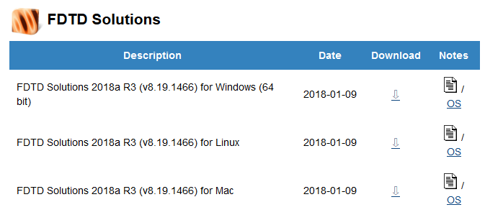
Installing FDTD Solutions
Log in here:
You will get an email with the license code
Download FDTD Solutions
Extract zip file
Run the installer
Start the program
https://www.lumerical.com/portal/workshop.html?ec=CDF54A

Slide 3
Installing FDTD Solutions
Check email for activation code
Enter it here
Click Activate

Slide 4
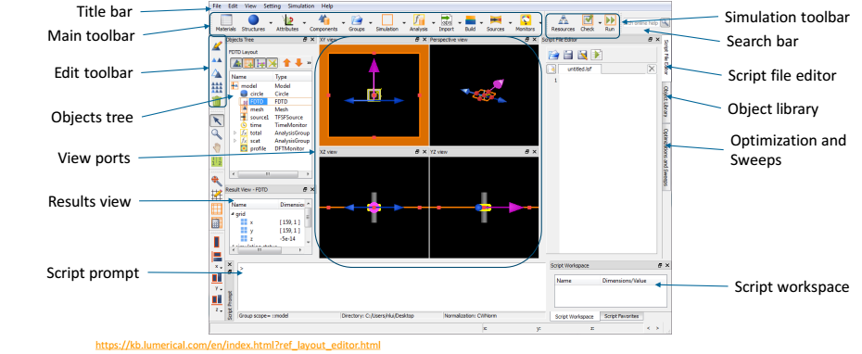
Lumerical FDTD program

